Slide 1
Start the Conversation
New Tools for Veteran Suicide Prevention
[Presenter name]
[Job title]
[Office]
[Date]
www.VeteransCrisisLine.net/starttheconversation
Notes:
Include in all decks

Slide 2
DELETE THIS SLIDE – Slide Deck “How-to” Guide
This presentation is intended to help Suicide Prevention Coordinators (SPCs) and suicide prevention advocates introduce audiences to Start the Conversation: New Tools for Veteran Suicide Prevention, a comprehensive toolkit that includes information about common issues that many Veterans face.
The slide deck is separated into eight sections. Each section has a brown topic slide to introduce the section and to provide an overview of the information included within.
This presentation is NOT meant to be used in its entirety. The slide deck includes general information for all audiences, along with information tailored to specific audiences, allowing SPCs to customize the presentation for their needs.
When viewing the presentation in “Normal View,” there are instructions included in the “Notes” section at the bottom about whether the slide is intended to be used for all presentations or whether it should only be used when relevant to your audience.
To tailor a presentation and delete slides that are not applicable to your audience, click on the slide on the left side navigation bar and click the “delete” button on your keyboard. You can also right click on an individual slide in the navigation bar and click on the “Delete Slide” option.
Many of the slides (including this slide) also include additional information in the “Notes” section that provide background information and guidance for talking points.
Notes:
For SPCs only - Directions for how to use this PowerPoint deck. Delete this slide before presenting to an audience.
Slide Deck “How-to” Guide
This presentation is intended to help Suicide Prevention Coordinators (SPCs) and suicide prevention advocates introduce audiences to Start the Conversation: New Tools for Veteran Suicide Prevention, a comprehensive toolkit that includes information about common issues that many Veterans face, as well as concrete steps to help audiences:
Talk to a Veteran about their emotional health, distress, or even thoughts of suicide
Identify factors that may increase a Veteran’s risk for suicidal thoughts and behaviors
Recognize warning signs or “red flags” indicating that a Veteran may be in crisis and need support
Create a personalized plan to help a Veteran manage crises with a customizable Safety Planning Worksheet
Access resources for Veterans in need and those who care about them
The slide deck is separated into eight sections. Each section has a brown topic slide to introduce the section and provide an overview of the information included within. The sections included in the slide deck are:
Introduction: Provides information for the audience about suicide prevention and why it’s important. This section also provides an overview of VA’s role in suicide prevention and information about the toolkit.
Risk Factors: Information about risk factors for Veterans and why they experience higher rates of crisis.
Warning Signs: A general list and description of suicide warning signs and resources that are applicable across all audiences.
Conditions: Information and resources focused on common medical conditions Veterans may face.
Life Experiences: Information and resources focused on common life experiences of Veterans.
Start the Conversation: Provides information about how to initiate a conversation about suicide with a Veteran. This section also provides tailored information for specific audiences.
Safety Planning: Information about what a safety plan is and who should have one, as well as strategies and tips for completing a safety plan with someone who is at risk for suicide.
Support and Resources: Provides VA and national resources along with tailored resources for specific audiences.
This presentation is NOT meant to be used in its entirety. The slide deck includes general information for all audiences, along with information tailored to specific audiences, allowing SPCs to customize the presentation for their needs.
When viewing the presentation in “Normal View,” there are instructions included in the “Notes” section at the bottom about whether the slide is intended to be used for all presentations, or whether it should only be used when relevant to your audience. For example, in the “Conditions” section, there is information tailored to Veterans with TBI, depression, PTSD, etc. On these slides, the note states “Include when relevant [Topic].” However, in sections like “Safety Planning” where the information is appropriate for all audiences, the note says “Include in all decks.”
To tailor a presentation and delete slides that are not applicable to your audience, click on the slide on the left side navigation bar and click the “delete” button on your keyboard. You can also right click on an individual slide in the navigation bar and click on the “Delete Slide” option.
Many of the slides also include additional information in the “Notes” section that provides background and guidance for talking points. This information is also available to help guide your presentation when viewing the slide deck in “Presenter Mode.”
Start the Conversation: New Tools for Veteran Suicide Prevention is also available online at www.VeteransCrisisLine.net/starttheconversation.

Slide 3
Introduction
Suicide is the 10th leading cause of death in the U.S.*
But it is preventable. You can make a difference.
*National Vital Statistics System, National Center for Health Statistics, CDC (2014)
Notes:
Include in all decks
(Citation source: http://www.cdc.gov/injury/images/lc-charts/leading_causes_of_death_age_group_2014_1050w760h.gif, accessed July 25, 2016)

Slide 4
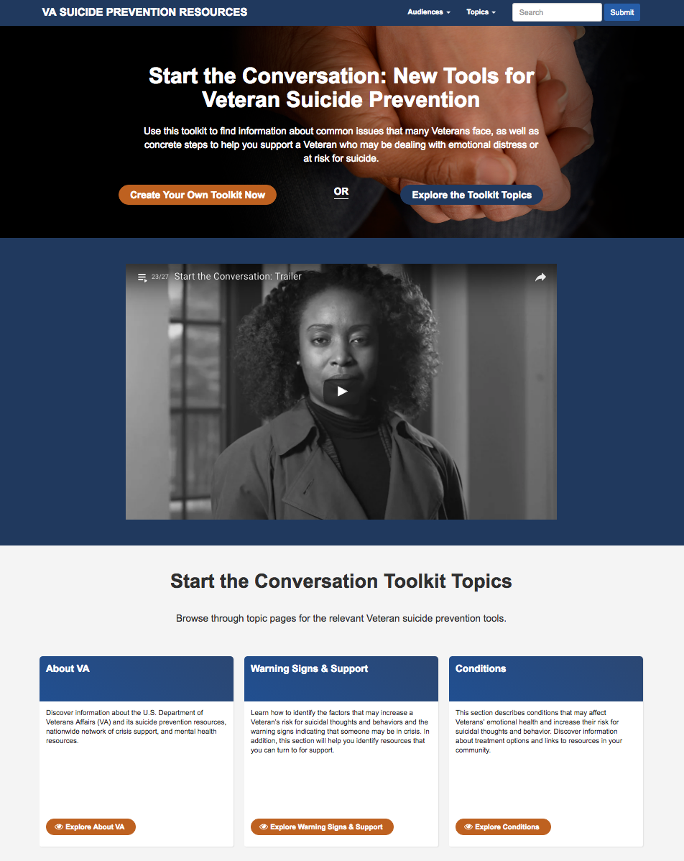
Resources are available to help start the conversation
Start the Conversation: New Tools for Veteran Suicide Prevention is a comprehensive toolkit that includes information about common issues that many Veterans face.
It provides information about how to:
Talk to a Veteran about emotional health, distress,
and thoughts of suicide
Identify suicide risk factors
Recognize warning signs or “red flags”
Create a personalized plan to help a Veteran
manage crises
Access resources for Veterans and those who care
about them
Notes:
Include in all decks [Intro 1 of 3]
Veterans face many unique challenges — from experiences of combat and deployments far from home to reintegration into civilian life. Some Veterans begin to feel overwhelmed by these challenges and may not know where to turn for support.
Each of us can make a difference in the life of a Veteran who is feeling stressed, anxious, or hopeless. One conversation or connection can be a pivotal step in helping a Veteran in need. A toolkit from the U.S. Department of Veterans Affairs (VA) — Start the Conversation: New Tools for Veteran Suicide Prevention — can help you get started.
Start the Conversation: New Tools for Veteran Suicide Prevention is a comprehensive toolkit that includes information about common issues that many Veterans face, as well as concrete steps to help you:
Talk to a Veteran about their emotional health, distress, or even thoughts of suicide
Identify factors that may increase a Veteran’s risk for suicidal thoughts and behaviors
Recognize warning signs or “red flags” indicating that a Veteran may be in crisis and need support
Create a personalized plan to help a Veteran manage crises with a customizable Safety Planning Worksheet
Access resources for Veterans in need and those who care about them

Slide 5
Customize the toolkit for Veterans and intermediaries
Tailored information for Veterans at higher risk:
Transitioning Service members
Women Veterans
LGBTQ Veterans
Aging Veterans
Suicide attempt survivors
Information for those who are concerned about a Veteran:
Family members
Clinicians
Co-workers
Individuals in the community
Notes:
Include in all decks [Intro 2 of 3]

Slide 6

VA has developed a network of support for Veterans
The U.S. Department of Veterans Affairs (VA) offers the Nation’s largest, most comprehensive Veteran-focused suicide prevention program.
More than 300 Suicide Prevention Coordinators (SPCs) nationwide
VA Resource Locator – connect with local SPCs and services (www.VeteransCrisisLine.net/ResourceLocator)
VA Mental Health resources – high-quality support and services (www.MentalHealth.va.gov)
Explore VA – learn about programs Veterans may be eligible for (www.Explore.va.gov)
Notes:
Include in all decks [Intro 3 of 3]
SPCs – Nationwide, more than 300 SPCs work closely with Veterans to help them get the support they need to address life’s challenges. In addition to case management work with Veterans, SPCs are the “boots on the ground” for VA’s suicide prevention education initiatives — providing ongoing training to all VAMC clinicians and staff and promoting awareness of suicide risk and prevention through community outreach events. Veterans can contact their local VAMC using the VA Resource Locator to schedule an appointment with an SPC near them.
VA Resource Locator – VA’s resource locator helps Veterans and their families connect with local treatment centers, SPCs, and other programs in their communities for customized support.
VA Mental Health resources – VA’s Suicide Prevention program combines high-quality mental health support and services with programs designed to help Veterans and their families connect with VA and community resources. Examples include VA’s resource locator, Make the Connection, VA.gov, VA’s Community Provider Toolkit, Coaching into Care, Vet Centers, and VA Caregiver Support. Visit the toolkit online and click on “About VA” for links to these resources.
Explore VA offers a fast and easy way for Veterans and their families to learn about programs they may be eligible for. VA benefits and services help Veterans take care of family members, buy a home, earn a degree, start a career, stay healthy, and so much more.

Slide 7
Risk and Protective Factors
Information about risk factors for Veterans and why they may experience higher rates of crisis

Slide 8
Factors that may contribute to increased risk
Male gender
Previous suicidal behavior
Recent tragedy or loss
Serious or chronic medical condition or illness
Sleep deprivation
Access to lethal means, such as a firearm or pills
History of abuse or trauma
Family history of suicide
Family history of depression or mental illness
Family history of substance misuse
Notes:
Include in all decks
A key step in suicide prevention is understanding the risk factors that make people more likely to consider harming themselves, as well as signs that indicate they are in crisis. It is also critical to learn what factors may reduce the risk that suicidal behavior and suicide will occur. Although risk factors do not cause a behavior or outcome to occur, they may be associated with an increased risk for the behavior or outcome.

Slide 9
Risk factors – firearms
Notes:
Include when relevant [Risk Factors: LGBTQ Veterans]

Slide 10
Risk factors – aging Veterans
Notes:
Include when relevant [Risk Factors: Aging Veterans]

Slide 11
Risk factors – women Veterans
Notes:
Include when relevant [Risk factors: Women Veterans]

Slide 12
Risk factors – attempt survivors
Notes:
Include when relevant [Risk factors: Attempt survivors[

Slide 13
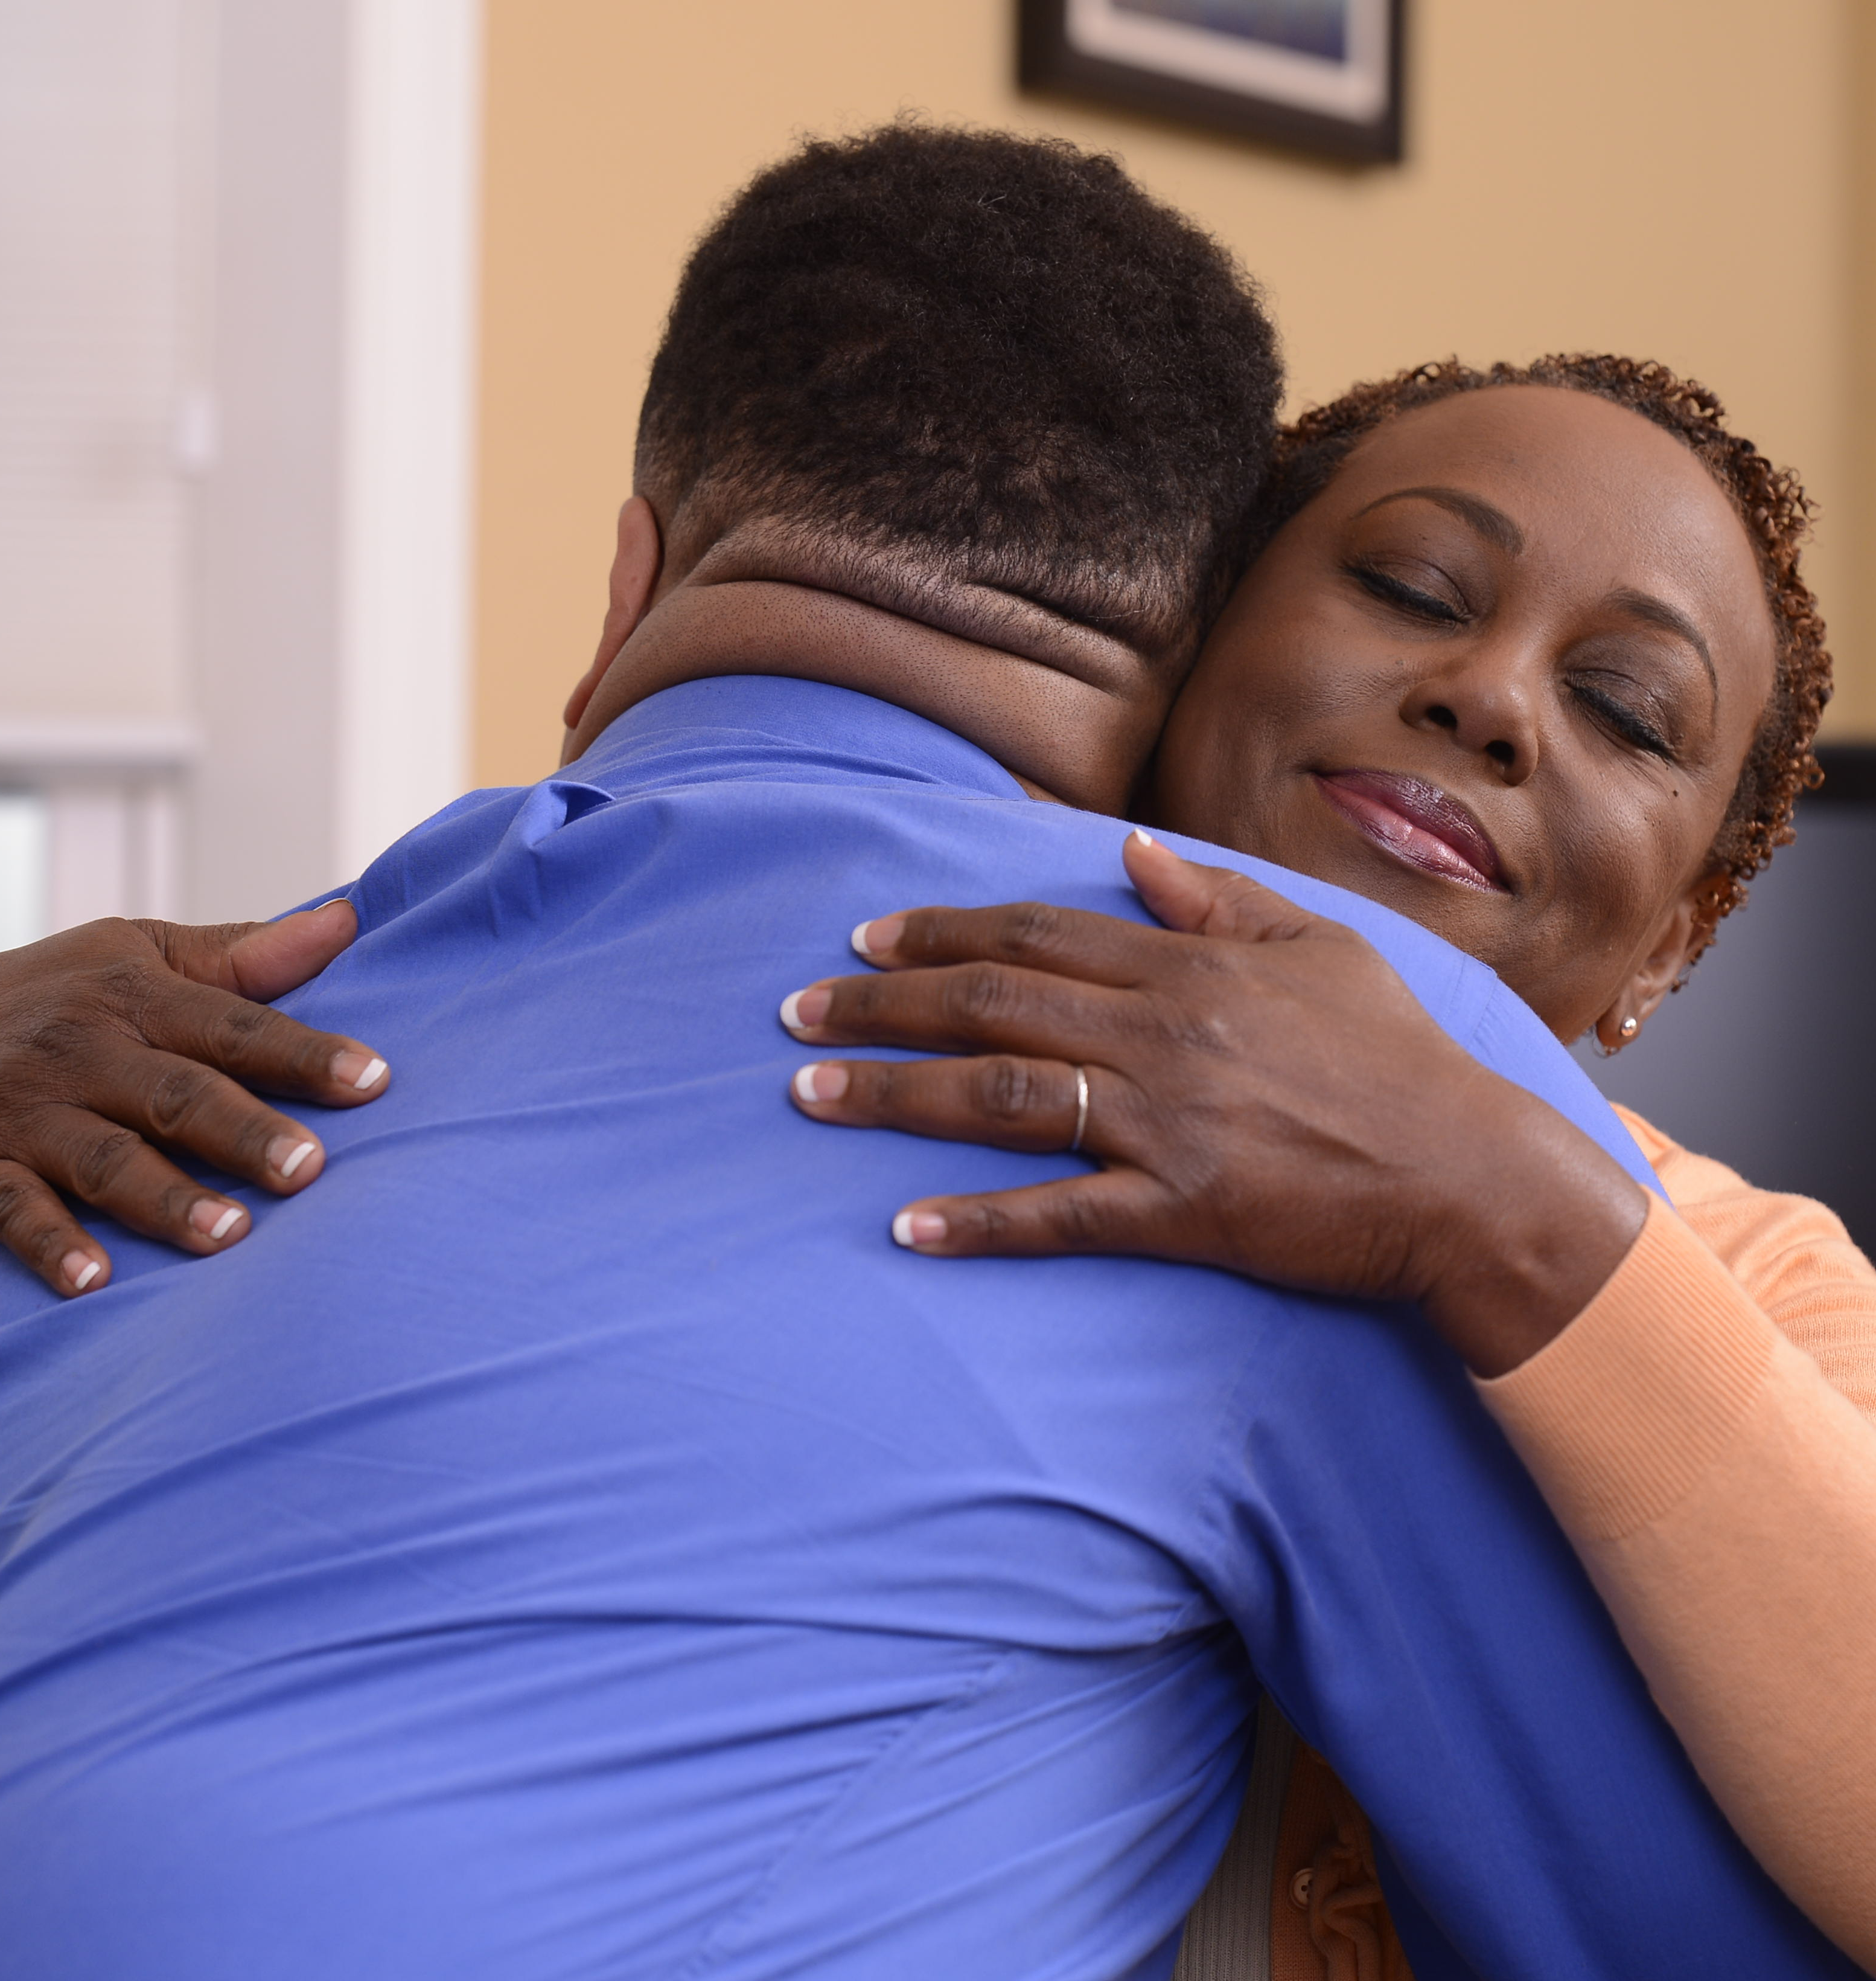
Protective factors can help prevent a crisis
Feeling connected to others
Having people to rely on and to share personal experiences with
Having a caretaker role
Skills to solve problems and manage challenges positively
Belief in a higher power or having a sense of meaning or purpose in life
Good physical and emotional health
Restricted access to lethal means
Willingness to seek treatment
Notes:
Include in all decks
Researchers have identified the following factors as likely to reduce the risk for suicidal behavior and suicide in a person going through a difficult time:
Feeling connected (to a relative, friend, community, or job, for example)
Having people to rely on and to share personal experiences with
Having a caretaker role (to children or cherished pets, for example)
Having skills to solve problems and manage challenges positively
Believing in a higher power or having a sense of meaning or purpose in life
Being in good physical and emotional heath
Having restricted access to lethal means
Being willing to seek treatment

Slide 14
Warning Signs
A general list and description of suicide warning signs and resources that are applicable across all audiences
Notes:
Include in all decks

Slide 15
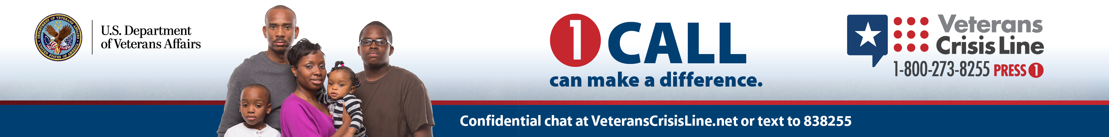
Know the warning signs of a mental health crisis
If you notice any of the following, get help immediately or encourage your Veteran to do so:
Engaging in self-destructive behavior, such as drug abuse or reckless use of weapons
Thinking about hurting or killing oneself
Looking for ways or having a set plan in place to kill oneself
Talking about death, dying, or suicide
Saying goodbye to friends and family
Putting personal affairs in order or giving away possessions
Notes:
Include in all decks [Warning Signs]: While risk factors may increase the chances that a problem may occur, certain signs indicate that a problem may be unfolding. There are several red flags that signal a Veteran may be in crisis.

Slide 16
Common Conditions and Experiences
Information and resources focused on common medical conditions and life experiences
that Veterans may face
Notes:
Include in all decks

Slide 17
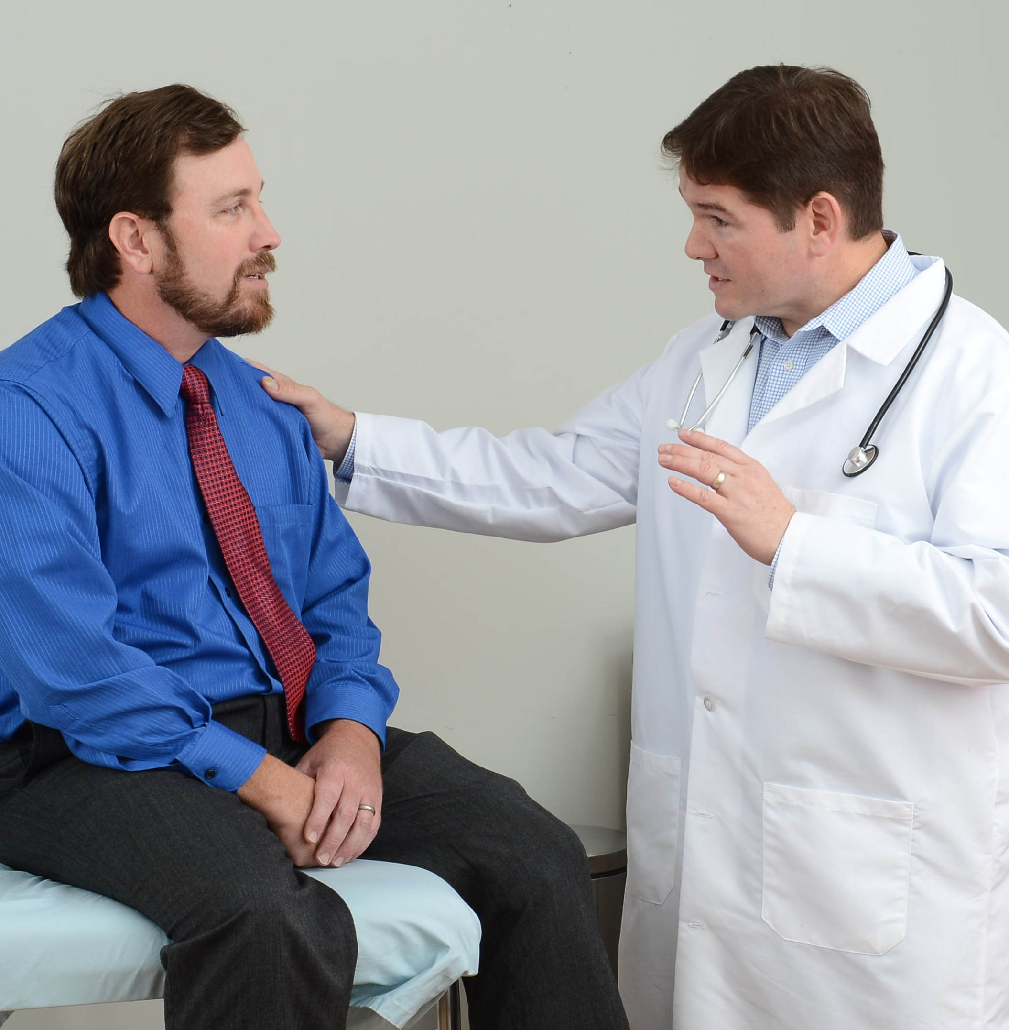
TBI and suicide prevention
Traumatic brain injury (TBI) is caused by a blow or jolt to the head that affects normal brain functioning.
TBI can impair an individual’s ability to:
Think
Control emotions
Move fluidly
Speak
See
Hear
Notes:
Include if relevant [TBI 1 of 4]
TBI can result from hitting the windshield in a car accident, an impact from a fall, a collision while playing sports, or a blast wave from a nearby explosion in a combat zone.

Slide 18
Untreated TBI can affect mental health
Experiencing any of the following symptoms for more than seven days after a head injury means it’s time to seek treatment right away:
Feeling tired all the time
Feeling sad or anxious
Getting frustrated or overwhelmed easily
Sleeping much more or less than usual
Frequently feeling irritated or angry for most of the day
Acting impulsively — without thinking things through
Having trouble concentrating, remembering, or focusing on tasks
Not feeling like yourself
Notes:
Include if relevant [TBI 2 of 4]: TBI affects people in many different ways, and symptoms may change over time. Some TBI symptoms are immediately apparent following the impact, while others are slow to develop or may be confused with other conditions.

Slide 19
TBI can be successfully treated
For discussion with a doctor during a TBI evaluation:
What caused your injury
How to deal with TBI’s physical, cognitive, and behavioral symptoms and other impacts on daily life
If counseling is right for you
If medication can help relieve TBI’s effects on how your brain functions
Recovery is faster if you:
Get enough rest
Don’t push yourself too hard
Gradually increase your activity level
Consider whether or not some activities make your symptoms worse
Notes:
Include if relevant [TBI 3 of 4]: If left untreated, the effects of TBI can affect the way you live your life and your personal relationships. Ignoring your symptoms and trying to “tough it out” may affect your well-being and mental health.
Some people with TBI begin to have distressing thoughts or no longer feel like themselves. Though not all distressing thoughts and emotions lead to a crisis, if left unchecked, they could become a serious issue over time.
Many Veterans receive effective treatment for TBI. During a TBI evaluation, you and your doctor will discuss:
What caused your injury
How to deal with TBI’s physical, cognitive (e.g., concentration difficulties, headaches), and behavioral symptoms and other impacts on your daily life
If counseling is right for you
If medication can help relieve TBI’s effects on how your brain functions
Most doctors who treat head injuries agree that recovery is faster if you follow this guidance:
Get enough rest
Don’t push yourself too hard
Gradually increase your activity level
Consider whether or not some activities make your symptoms worse

Slide 20
It’s possible to manage TBI symptoms
Get enough sleep
Write things down, or use electronic reminders, if you have trouble remembering
Establish a regular daily routine
Avoid alcohol, caffeine, cold medications that treat nasal congestion, or other products that contain pseudoephedrine, which may worsen symptoms
Recognize triggers – keep a record to help identify situations that are more likely to worsen your symptoms
Talk to others to avoid feeling isolated and to give friends and loved ones a chance to support you
Notes:
Include if relevant [TBI 4 of 4]:
There are also steps you can take to help manage your TBI symptoms:
Get enough sleep
Write things down, or use electronic reminders, if you have trouble remembering
Establish a regular daily routine
Avoid alcohol, which can slow down the healing process and make symptoms worse
Avoid caffeine, cold medications that treat nasal congestion, or other products that contain pseudoephedrine, which may increase the symptoms
Recognize triggers — keep a record to help identify situations that are more likely to worsen your symptoms
Talk to others to keep you from feeling isolated and to give friends and loved ones a chance to help you

Slide 21
Chronic pain and suicide prevention
Acute pain
Short-term pain
A useful signal that something may be wrong with our bodies
Once the source of pain has resolved, the pain goes away
Chronic pain
May persist for months or years
May be due to an injury that permanently alters the body
Can persist even after an injury has healed or been resolved
Whether the source is known or unknown, Veterans suffering from chronic pain may need help.
Notes:
Include if relevant [Chronic Pain 1 of 2]

Slide 22

Chronic pain can be dealt with in a variety of ways
Short-term strategies to manage pain:
Tell your doctor about it
Educate yourself on chronic pain so you can decide on the best options for managing your condition
Keep a “pain diary”
Find ways to stay physically active
Treatment options can include:
Physical therapy
Therapy or counseling
Relaxation techniques
In some cases, prescription medications
Notes:
Include if relevant [Chronic Pain 2 of 2]: Many people who have chronic pain find that the constant discomfort and the restrictions it places on their daily activities contribute to feelings of sadness, irritability, or hopelessness. Some people may begin to feel depressed or helpless if they think that the pain will never end and that there is nothing they can do about it.
Not all distressing thoughts and emotions lead to a crisis — but if left unchecked, they could become a serious issue over time. If you notice any of the warning signs discussed earlier, get help immediately or encourage your Veteran to do so.
Your friends and family members have likely noticed that your chronic pain is affecting your well-being. Talking to them can be especially helpful as you look for the type of relief that is right for you.
If you are experiencing chronic pain, there are a few things you can do right away to deal with your symptoms:
Tell your doctor about it — a physician can help develop a treatment plan for you
Educate yourself on chronic pain so you can decide on the best options for managing your condition
Keep a “pain diary” to record how your experience of pain may change throughout the day and how pain affects your daily life
Find ways to stay physically active, according to the recommendations of your doctor
Depending on what is causing the pain, various treatment options may relieve it, such as:
Physical therapy to increase your level of pain-free activity
Therapy or counseling to help you learn ways to manage your pain
Relaxation techniques to manage the stress of chronic pain
In some cases, prescription medications to reduce the level of severe pain

Slide 23
Substance misuse and suicide prevention
Sources of support include:
Your family doctor
A mental health professional
Local support groups, such as Alcoholics Anonymous (AA) or Narcotics Anonymous (NA)
Your local VA Medical Center or Vet Center
A spiritual or faith-based adviser
You don’t have to deal with alcohol or drug problems alone.
Notes:
Include when relevant [Substance Misuse 1 of 2]: Individuals sometimes misuse alcohol and/or drugs as a means to cope with stressful life experiences and emotional challenges. If you notice that your increased drinking or drug use coincides with feelings of hopelessness, aggression, withdrawal, or anxiety, it’s time to reach out for support.
Quitting or cutting back on drinking or drug use can be challenging. Trying to do it on your own, without any support, can make it even harder. Talking to family and friends can be a helpful first step. Loved ones can offer encouragement and support, and they may be able to connect you with resources that can promote your path to recovery.
Get counseling, either one-on-one with a therapist or in a group with others who are working on similar concerns. In addition, there are options for medications that may help you reduce your use of alcohol or drugs. You can work with your counselor or doctor to try different types of treatment. Remember: Finding the care that’s right for you may take some time. Be patient with the process, and try to keep an open mind as you work toward recovery.
When Veterans use alcohol and drugs as their primary means to cope, the consequences can be severe.
You don’t have to deal with alcohol or drug problems alone. Consider contacting:
Your family doctor, who may know you well and be able to offer support, guidance, and appropriate referrals, including to a doctor who has extensive experience treating Veterans with substance misuse disorders if yours does not
A mental health professional, such as a therapist
Local support groups, such as Alcoholics Anonymous (AA) or Narcotics Anonymous (NA)
Your local VA Medical Center or Vet Center: VA specializes in the care and treatment of Veterans
A spiritual or faith-based adviser

Slide 24

Substance misuse and suicide prevention
Individuals sometimes misuse alcohol and/or drugs as a means to cope with stressful life experiences and emotional challenges
If you notice that your increased drinking or drug use coincides with feelings of hopelessness, aggression, withdrawal, or anxiety, it’s time to reach out for support
Notes:
Include when relevant [Substance Misuse 2 of 2]

Slide 25
Veteran PTSD and suicide prevention
Some factors can increase the likelihood of a traumatic event leading to PTSD, such as:
The intensity of the trauma
Being hurt or losing a loved one
Remaining physically close to the site of the traumatic event
Feeling as if you were not in control
Having no or little support after the event
Notes:
Include when relevant [PTSD 1 of 3]: If you experienced severe trauma or a life-threatening event before, during, or after service, you may have developed symptoms of extreme stress — commonly known as posttraumatic stress disorder (PTSD).
What factors can increase the risk for PTSD?
Sometimes symptoms of PTSD don’t surface for months, or even years, after a traumatic event or deployment. Symptoms also may come and go. If these problems don’t go away — or, worse, if you feel like they are disrupting your daily life — you may have PTSD.

Slide 26
Recognizing signs of PTSD is the first step to recovery
Common symptoms include:
Recurring memories or nightmares of certain events
Sleeplessness
Loss of interest in things you used to enjoy
Feeling numb, angry, and/or irritable
Reactions to symptoms can be disruptive, too:
Frequently avoiding places or things that remind you of what happened
Turning to drinking or using drugs to numb feelings
Considering harming yourself or others
Pulling away from other people and becoming isolated
Notes:
Include when relevant [PTSD 2 of 3]: Veterans with PTSD experience a variety of symptoms, some of which may be difficult for others to detect. Symptoms can occur immediately after a specific event or can surface weeks, months, or even years later. Learning to recognize these symptoms is the first step to feeling better.

Slide 27

Every day, Veterans with PTSD get better
Treatment works.
Be patient and persistent
Contact your family doctor for support
Lean on local mental health professionals, counselors, or a spiritual or religious adviser, for support
Notes:
Include when relevant [PTSD 3 of 3]:
These treatments can produce positive and meaningful changes in your symptoms and quality of life. They can help you understand and change how you think about your trauma — and change how you react to stressful memories.
The two main types of treatment are talk therapy and medication. Research shows that talk therapy, such as prolonged exposure therapy or cognitive processing therapy, can help Veterans with PTSD. Likewise, medications, such as selective serotonin reuptake inhibitors (SSRIs), have been shown to be effective in reducing PTSD symptoms. Some individuals experience benefits from combining these two types of treatment.
PTSD treatment has improved quite a bit over the years — so if you tried talk therapy or medication in the past and still have symptoms, it would be good to try again.
Treatment works.
Be patient and persistent. You may need to work with your doctor or therapist to try different types of treatment before finding what works most effectively to treat your PTSD symptoms.
Consider contacting your family doctor, who may know you well and be able to offer support, guidance, and appropriate referrals during a crisis.
Local mental health professionals, such as a therapist, counselor, or spiritual or religious adviser, can provide additional support.

Slide 28

What does depression look like?
Consider whether your thoughts, moods, or behaviors have changed noticeably:
Is your mood different than “usual” for you?
Have others noticed a difference?
Most common symptoms of depression:
Feeling sad or down
Losing interest in or not getting enjoyment from activities you once found pleasurable
If you experience either of these symptoms nearly every day for at least two weeks, you may be depressed.
Notes:
Include if relevant [Depression and Suicide 1 of 3]: The signs and symptoms of depression may be hard to notice at first. Everyone experiences sadness, irritability, or low energy from time to time. Depression is different. If you have depression, it can be hard to engage in everyday activities. You might focus on what’s not going well in your life and may be unable to enjoy activities that typically bring you pleasure. Depression can put a strain on your relationships and sometimes may lead to feelings of despair.
While depression isn’t always caused by a specific event, some Veterans experience it because of the loss of someone close to them, relationship conflicts (such as separation or divorce), or a job change or loss. When this sadness lasts for more than a few weeks or is significantly affecting your life, it may be a sign of depression. No matter what the source may be, it’s important to seek treatment.

Slide 29
Depression shows itself in several ways
Gaining or losing weight
Eating more or less than usual
Having difficulty sleeping, or sleeping more than usual
Feeling restless and unable to sit still, or the opposite (moving more slowly than usual)
Feeling tired or as if you have no energy
Feeling excessively guilty over things you have done or not done
Having low self-esteem or feeling down on yourself
Finding it hard to focus, remember things, or make decisions
Feeling hopeless
Thinking about death, or feeling that life is not worth living
Notes:
Include if relevant [Depression and Suicide 2 of 3]: Not everyone with depression has the same symptoms or feels the same way. One person might have difficulty sitting still, while another may find it hard to get out of bed each day.
Having thoughts that others would be better off without you, feeling that there’s no way out of your problems, or thinking about harming oneself, or about suicide, are very serious symptoms of depression and need immediate attention.

Slide 30

Depression can be effectively treated
Psychotherapy can help you:
Learn new ways to manage your symptoms
Improve relationships
Change maladaptive thinking
Discover new solutions to life’s challenges
Notes:
Include if relevant [Depression and Suicide 3 of 3]: Antidepressant medications work in different ways to affect the neurochemicals in your brain that may be associated with depression. You may need to work with your doctor or counselor to try different types of treatment before finding what works best for you.
Depression is a condition that can be effectively treated.
If you are depressed, treatment can help. Treatments for depression can involve psychotherapy or counseling, medication, or a combination.

Slide 31

Signs to look for when transitioning from service
Frequently feeling on edge or tense
Having difficulty concentrating
Feeling angry or irritable
Having trouble sleeping
Feeling down for weeks or months
Notes:
Include when relevant [Transitioning 1 of 2]
Some of the challenges that come with transitioning from the military can be difficult or stressful. They can put a strain on your relationships and may lead to feelings of despair. If you notice any of the warning signs discussed earlier, get help immediately or encourage your Veteran to do so.
Returning to civilian life can present new opportunities — and new challenges including:
Finding a job
Going back to school
Learning how to adjust

Slide 32
Strategies to ease the transition from service
Reach out to other Veterans or to Veterans’ groups for social support
Be prepared for insensitive questions or topics of conversation, practice how to respond, and respectfully decline to talk about things that make you uncomfortable
Have a plan of action for your adjustment
Prioritize getting a good night’s sleep
Exercise regularly and eat healthy meals
Practice relaxation techniques, such as deep breathing
Avoid unhealthy “quick fixes”
Notes:
Include when relevant [Transitioning 2 of 2]
Going from something familiar, like military life, to something new and different can be challenging.
Your experiences in the service — both positive and negative — may have changed the way you look at things and deal with people. Stressful or traumatic situations may have resulted in habits or ways of coping that may be misunderstood or may cause problems in civilian life.
These strategies can ease a transition and build a foundation for success:
Reach out to other Veterans or to Veterans’ groups for social support. Recognize that others may not always agree with you or understand your military service, and agree to disagree
Be prepared for insensitive questions or topics of conversation, practice how to respond before you hear them, and respectfully decline to talk about things that make you uncomfortable
Have a plan of action for your adjustment that includes a list of goals for your transition, future, and personal life
Try to get a good night’s sleep as often as possible
Exercise regularly and eat healthy meals
Practice relaxation techniques, such as deep breathing
Avoid unhealthy “quick fixes” that you think may help you cope, such as drinking alcohol, taking drugs, or smoking cigarettes
Most Veterans go through some period of adjustment as they transition from military service to civilian life. For some Veterans, the challenges continue — affecting their health and well-being, including:
Frequently feeling on edge or tense
Having difficulty concentrating
Feeling angry or irritable
Having trouble sleeping
Feeling down for weeks or months
Some of the challenges that may come with transitioning from the military can be difficult or stressful and may lead to despair.
No matter what you’re facing, you don’t have to deal with it alone. If you notice any of the warning signs discussed earlier, get help immediately or encourage your Veteran to do so.

Slide 33
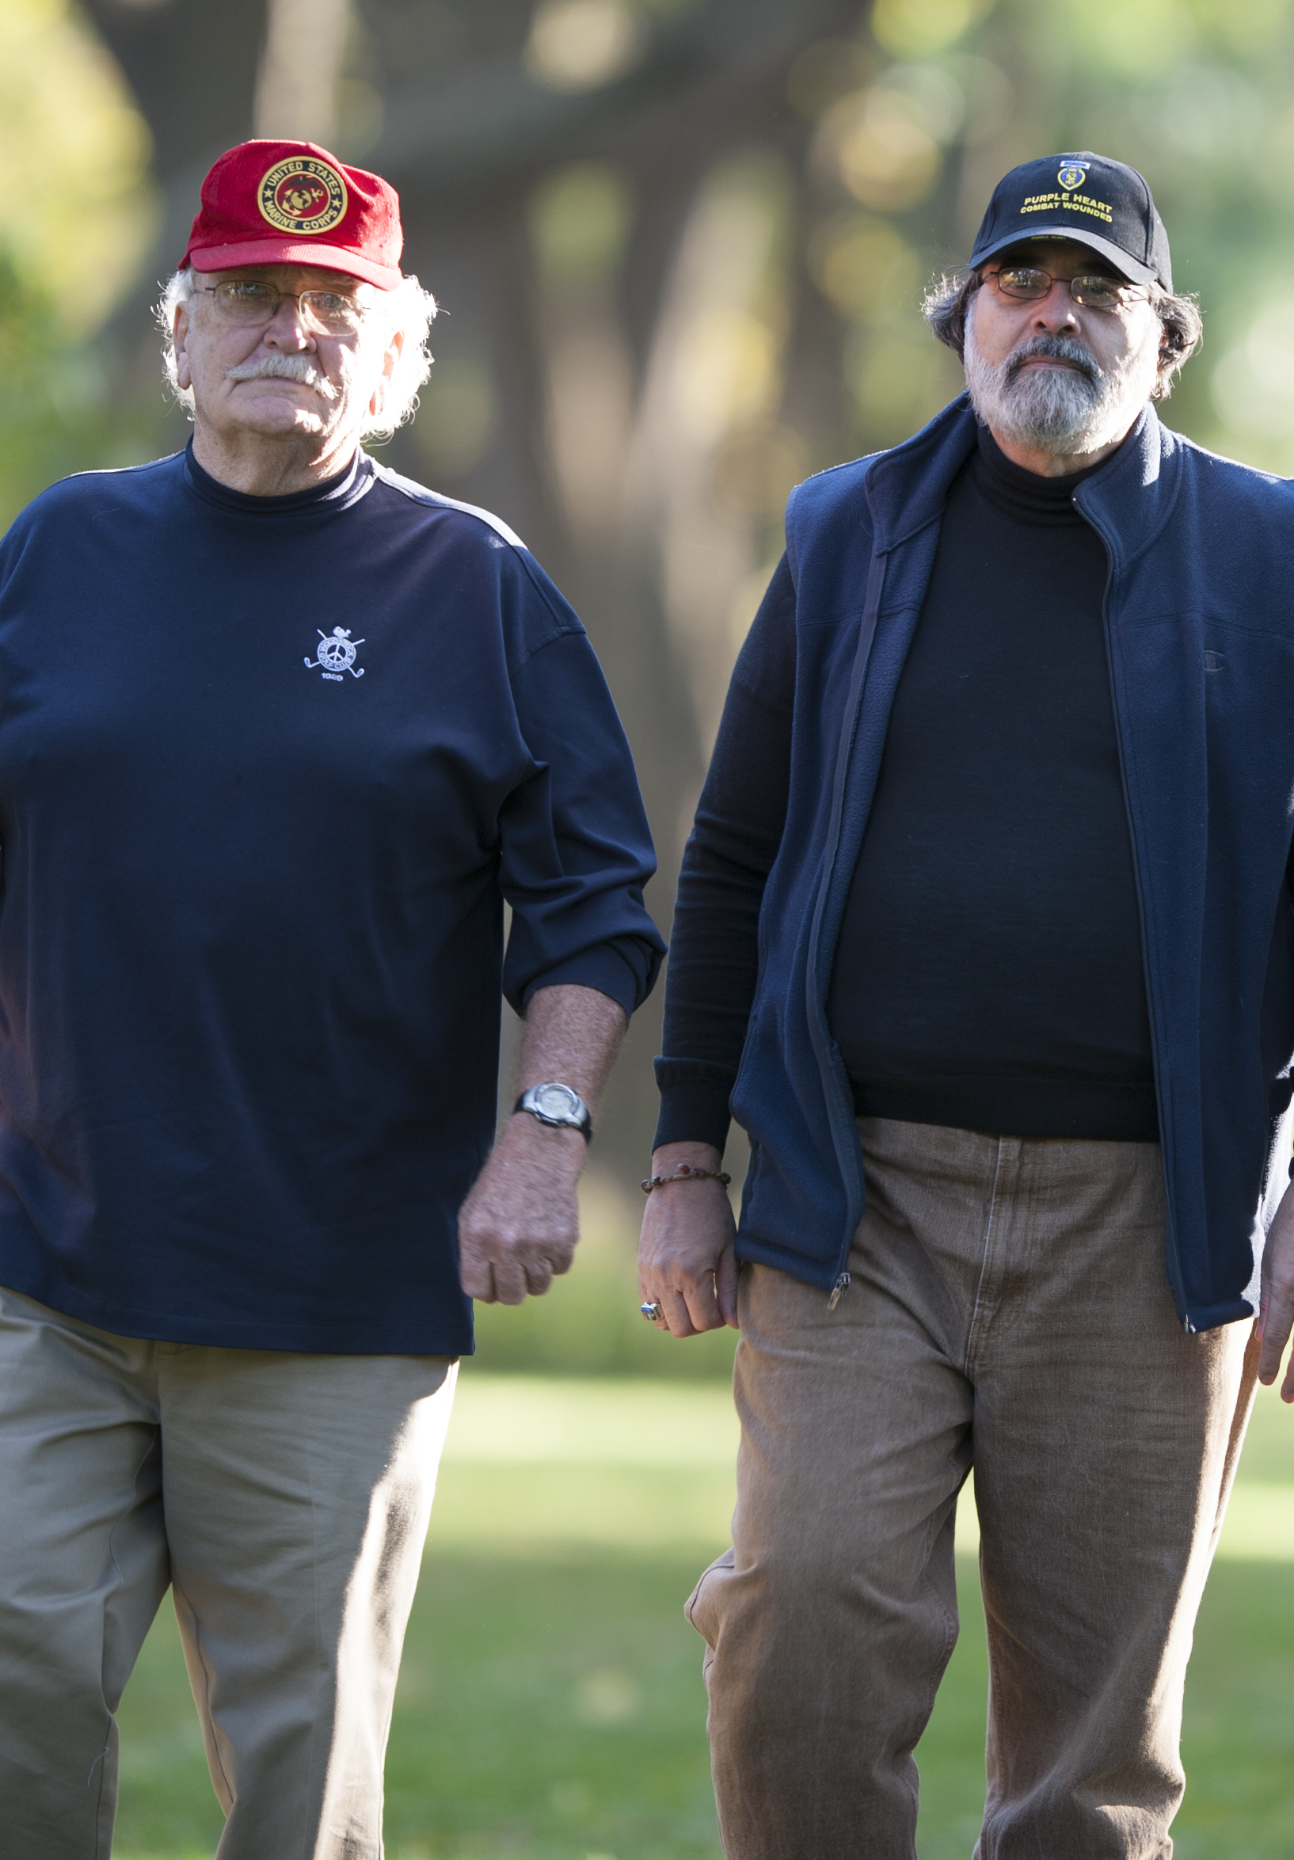
Aging and retirement can present life challenges
Having fewer distractions and more unstructured downtime
Feeling like your days lack focus without the routine of work
Losing touch with co-workers and friends
Experiencing the death of loved ones
Feeling upset when hearing about current events or
news reports
Feeling unhappy about your body’s physical changes
Becoming tired more quickly, feeling weaker, or needing to
rest more frequently
Noticing changes in your ability to hear or see as well as you did when you were younger
Having a slower sexual response
Worrying about financial issues
Notes:
Include when relevant [Aging and Retirement 1 of 2]
While gradual physical changes are a normal part of aging, excessive worry, fatigue, and unhappiness are not. They indicate that an older Veteran may need support.
While retirement is an exciting phase for many people, certain issues can make planning for retirement challenging, including:
Having fewer distractions and more downtime to recall troubling events from your past, including combat and other military experiences
Losing touch with co-workers and friends
Feeling like your days lack focus without the routine of work
Feeling upset when hearing about current events or news reports that may bring back memories of negative events during military service

Slide 34
Strategies to ease the aging/retirement process
Be willing to ask others for support
Talk to other Veterans or friends and family with experiences similar to yours
Enjoy a healthy lifestyle; combine an exercise routine with a healthy diet
Quit smoking
Refrain from excessive drug and alcohol use
Consider connecting with:
Your family doctor
A mental health professional
Your local VA Medical Center or Vet Center
A spiritual or faith-based adviser
Notes:
Include when relevant [Aging and Retirement 2 of 2]
Some of the challenges that may come with one. aging and retirement can be difficult or stressful and can put a strain on your relationships. You might feel down on yourself or find it harder to enjoy the things you usually do. You may be dealing with chronic pain or medical conditions, or facing the illness or death of a loved
No matter what you’re facing, you don’t have to deal with it alone.
If you notice any of the warning signs discussed earlier, get help immediately or encourage your Veteran to do so.

Slide 35
What is military sexual trauma (MST)?
MST includes:
Any sexual activity in which you were involved against your will, whether you were physically forced or not
Sexual activities that happened while you were unable to give your consent, such as when intoxicated
Unwanted sexual touching or grabbing; threatening, offensive remarks about your body or your sexual activities; and threatening and unwelcome sexual advances
Notes:
Include when relevant [MST 1 of 2]
It’s important to know that MST can occur on or off base, during war or peacetime, and while a Service member is on or off duty. Perpetrators may be men or women, military personnel or civilians, or superiors or subordinates in the chain of command. They may be a stranger — or even a friend or intimate partner. Veterans from all eras of service have reported experiencing MST.
It’s not uncommon for people who experience sexual assault or harassment during their service to blame themselves or feel ashamed. It is important to remember that MST is not your fault. Nothing ever justifies sexual harassment or assault.
Dealing With the Effects of Military Sexual Trauma (MST)
Both female and male Service members sometimes have upsetting, unwanted sexual experiences, including sexual assault or sexual harassment. VA refers to these experiences as “military sexual trauma.”
VA offers Veterans treatment and services to cope with the effects of MST.
Fortunately, people can recover from experiences of trauma, and VA has services to help Veterans move their lives forward. Treatment often involves addressing any immediate health and safety concerns, followed by counseling to help survivors cope with the effects of MST. Treatment may focus on strategies for managing difficult emotions and memories. When a Veteran is ready, it may involve talking about MST experiences in depth.
At VA, Veterans can receive free, confidential treatment for mental and physical health conditions related to MST — sometimes even if they’re not eligible for other VA services. To receive these services, you don’t need a VA service-connected disability rating, you don’t need to have reported the incident when it happened, and you don’t need any other documentation that it occurred. Every VA health care facility has an MST coordinator who can answer questions about VA’s MST services.

Slide 36

MST can have highly disruptive effects on survivors
Potential challenges include:
Strong emotions
Numbness
Sleep disturbances
Trouble with attention, concentration, and memory
Problems with alcohol or other drugs
Disturbing reminders of the trauma
Problems in relationships
Physical health problems
Notes:
Include when relevant [MST 2 of 2]
MST is an experience, not a diagnosis or condition in and of itself, and Veterans may react to it in a wide variety of ways. The emotional impact and other effects may not surface until months or years after the MST experience, and sometimes not until after a Veteran has left military service. For some Veterans, MST may continue to affect their mental and physical health, work, relationships, and everyday life many years after the experience.
Some of the difficulties MST survivors may face include:
Strong emotions: feeling depressed; having intense, sudden emotional responses; feeling angry or irritable much of the time
Numbness: feeling emotionally flat
Sleep disturbances: trouble falling or staying asleep; bad dreams or nightmares
Trouble with attention, concentration, and memory: difficulty staying focused, often finding your mind wandering; having a hard time remembering things
Problems with alcohol or other drugs: drinking to excess or using drugs daily; getting drunk or “high” to cope with memories or unpleasant feelings; drinking to fall asleep
Disturbing reminders of the trauma: feeling on edge or jumpy all the time; not feeling safe; going out of your way to avoid reminders of the trauma; having trouble trusting others
Problems in relationships: feeling alone or disconnected from others; engaging in abusive relationships; conflicts with employers or authority figures
Physical health problems: sexual issues; chronic pain; weight or eating problems; stomach or bowel ailments

Slide 37
Start the Conversation
Provides information about how to begin a conversation with a Veteran you are concerned about
Notes:
Include in all decks

Slide 38
One conversation can make a difference
Starting a conversation can help a Veteran feel valued and recognize that support is available
You don’t have to be an expert
If you notice changes in a Veteran’s behavior or moods, talk about your concerns and let the Veteran know you’re there and ready to listen
Remember: The goal is to provide support, not fix the situation.
The simple act of starting a conversation can
mean the difference between a tragic outcome and
a Veteran life saved.
Notes:
Include in all decks [Start the Conversation 1 of 4]
If you notice changes in a Veteran’s behavior or moods, start a conversation:
Talk about your concerns
Let the Veteran know you’re there
Let the Veteran know you care
Let the Veteran know you’re ready to listen

Slide 39
How do I start? What should I say?
Focus on your own observations and share your feelings first:
I’ve noticed you’ve been acting differently lately, and I’m wondering how you’re doing
I wanted to check in with you because you haven’t seemed yourself lately
I’ve been worried about you lately
Then ease into questions like:
When did you first start feeling like this?
Did something happen that made you begin to feel this way?
Are you having thoughts of hurting yourself?
Are you having thoughts of suicide?
What can I do to best support you right now?
Have you thought about getting help?
Notes:
Include in all decks [Start the Conversation 2 of 4]
Asking whether a Veteran is having thoughts of self-harm or suicide may seem extreme, but it is important. Many Veterans may not show clear signs of intent to harm themselves before doing so, but will answer direct questions about their intent to do so when asked. If you are starting a conversation because you are concerned about emotional or behavioral changes you see, questions about self-harm should be a part of that conversation.

Slide 40
How should I respond to the Veteran’s answers?
Simple, encouraging responses go a long way:
You’re not alone, even if you feel as if you are
I’m here for you, and I want to help you in any way I can
It may not seem possible right now, but the way you’re feeling will change
I might not be able to understand exactly what you’re going through or how you feel, but I care about you and want to help
When you want to give up, or feel overwhelmed by emotion, try to just focus on getting through the next minute, hour, or day — whatever you can manage
Notes:
Include in all decks [Start the Conversation 3 of 4]
If you notice changes in a Veteran’s behavior or moods, it’s time to open a line of communication. By starting a conversation about your concerns, you let the Veteran know you’re there, you care, and you’re ready to listen.
To help you feel confident when starting this conversation, remember: The goal is to provide support, not fix the situation. You should not feel that you need to solve the Veteran’s problems. By simply sharing your concern and listening to what the Veteran is saying, you are making a big impact.

Slide 41
How can I help after the crisis?
Seek professional help
Follow up on treatment recommendations
Be available and encouraging
Encourage healthy lifestyle changes
Contact a VA Suicide Prevention Coordinator (SPC) to help create a safety plan
Remove objects that could aid in self-harm
Notes:
Include in all decks [Start the Conversation 4 of 4]
Determining how to get help for someone who is thinking about suicide can be overwhelming.

Slide 42
Talking about firearm safety helps keep families safe
Make sure firearms cannot be accessed by children and unauthorized adults by keeping guns locked and unloaded when not in use
Store ammunition separately from firearms and out of the reach of children and unauthorized adults
Regularly reassess steps to ensure the safe storage and use of firearms, especially during periods of increased stress or emotional crisis
Request a gunlock from your local SPC
The best way to find out if a Veteran you’re concerned about has access to firearms is to ask.
Notes:
Include when relevant [Start the Conversation: Talking to a Veteran About Firearm Safety 1 of 2]
You have the power to initiate a conversation about safely handling and storing firearms.
Having a conversation with a Veteran about firearm safety can be challenging. As someone who likely had some level of firearm training during military service, the Veteran may not be receptive to talking about best practices for gun storage and security.
It can be helpful to frame your conversation around the safety of others — family, friends, or children who may not know how to properly handle a firearm or understand its dangers, which could result in accidental injury or death.

Slide 43
Be cautious when firearms are present
Take extra precautions when someone you’re concerned about is:
Increasingly isolated
Violent
Stressed
Depressed
Experiencing an emotional crisis or displaying significant behavioral change
Under the influence of drugs or alcohol or increasing the use of alcohol or drugs
A safely stored firearm can mean the difference between a tragic outcome and a life saved.
Notes:
Include when relevant [Start the Conversation: Talking to a Veteran About Firearm Safety 2 of 2]
At a minimum, all firearms should be stored, unloaded, and locked in a gun safe, cabinet, or storage case when not in use. Off-site storage may be advisable if there are concerns about the well-being of a Veteran or of family members.

Slide 44
How do I start a conversation about substance misuse?
Focus on your own observations and share your feelings:
[For alcohol] I’ve noticed you’ve been drinking a lot, and I’m wondering if everything is okay
[For alcohol and/or drugs] I’ve noticed you’ve been acting differently lately, and I’m wondering how you’re doing
I wanted to check in with you because you haven’t seemed like yourself lately
I’ve been worried about you lately
Then ease into questions like:
When did you first start feeling like this?
Did something happen that made you begin to feel this way?
Have you been drinking and/or using drugs to cope with these feelings?
Do you feel that drinking and/or using drugs is interfering with your life?
What can I do to best support you right now?
Have you thought about getting help?
Notes:
Include when relevant [Start the Conversation: Talking to a Veteran About Substance Misuse 1 of 2]
Remember: It’s important to listen without judgment. It may be a big step for the Veteran in your life to speak openly about their substance use. Show the Veteran you’re there for them by being supportive and receptive to what they say. Don’t lecture or give the impression that you’re disappointed in the Veteran. Lecturing the Veteran can make them feel guilty or as if they’re a burden to others.

Slide 45

How can I help after the crisis?
Seek professional help
Be available and encouraging
Encourage healthy lifestyle changes
Remove triggers that could contribute to a relapse
Notes:
Include when relevant [Start the Conversation: Talking to a Veteran About Substance Misuse 2 of 2]

Slide 46
How do I start a conversation about emotional pain with a patient?
Focus on your own observations:
You seem distant. What’s going on?
I’ve noticed you seem anxious, and I’m wondering how you’re doing.
You don’t seem like yourself. I’m worried about you and am curious about how you’re feeling.
Then ease into questions like:
When did you first start feeling like this?
Did something happen that made you begin to feel this way?
Are you having thoughts of hurting yourself?
Are you having thoughts of suicide?
What can I do to best support you right now?
Have you thought about getting help?
Notes:
Include when relevant [Start the Conversation: Talking to a Veteran Patient About Suicide 1 of 3]: Asking whether your patient is having thoughts of self-harm or suicide may seem extreme — especially if their troubles seem minor — but it is important. Many Veterans may not show clear signs of intent to harm themselves before doing so, but will answer direct questions about their intent to do so when asked. If you are starting a conversation because you are concerned about emotional or behavioral changes you see, questions about self-harm should be a part of that conversation. Being genuine and empathetic with your patient during therapeutic encounters will encourage the open communication.
Although some Veterans may be honest with their physician about the challenges they’re experiencing, others may not. If you notice your patient is showing warning signs of mental health challenges, it’s important to open up a line of communication. Your trusted counsel could be the turning point that encourages a Veteran to get help before they reach a crisis point.

Slide 47

Ask direct questions to assess for risk
Ask direct questions to assess:
Ideation: Are you going to kill yourself?
Plan: Do you have a plan for how you would kill yourself?
Means: Do you have what you need to carry out your plan (pills, a gun, etc.)?
Timeline: Do you know when you would
do it?
Notes:
Include when relevant [Start the Conversation: Talking to a Veteran Patient About Suicide 2 of 3]

Slide 48
Suicide risk varies: information for providers
Lower risk – some suicidal thoughts, no suicide plan, say they won’t hurt themselves
Moderate risk – suicidal thoughts, vague plan for self-harm that isn’t very lethal, say they won’t hurt themselves
High risk – suicidal thoughts, specific plan for self-harm that is highly lethal, say they won’t hurt themselves
Severe risk – suicidal thoughts, specific plan that is highly lethal — including the means to kill themselves and a time set for doing it, say they will kill themselves
If you are concerned about someone, call the Veterans Crisis Line
(1-800-273-8255 and Press 1) for support.
If someone is at severe risk of killing themselves, call 911 or the Veterans Crisis Line immediately.
Notes:
Include when relevant [Start the Conversation: Talking to a Veteran Patient About Suicide 3 of 3]

Slide 49
Children have an especially difficult time
After a suicide attempt or a death by suicide, a child may feel:
Abandoned
Responsible
Afraid
Guilty
Sad
Embarrassed
Confused
Angry
Lonely
In denial
Numb
Notes:
Include when relevant [Start the Conversation: Talking to a Child About Suicide 1 of 2]: Whatever feelings a child expresses, remind them that it’s OK to let it out. Not sharing their feelings is OK, too. Don’t force a child to tell you how they feel, and don’t tell them how they should feel.
Having a loved one attempt or die by suicide can be an especially difficult experience for children. A child may not understand:
What mental illness is
How depression, illness, and life circumstances can make people do things they would otherwise never do
How to articulate their feelings or discuss the situation

Slide 50
Use sensitivity when talking to a child about suicide
Pick a private place where the child feels comfortable and will feel free to talk
Describe what has happened, using language that is simple and general
Encourage the child to express their feelings
Ask the child about their worries and concerns
Be aware of your own feelings and the way that you are communicating to the child
Assure children that their family member is getting treatment or care if the person is still alive
Provide consistency; try to maintain the child’s routine
Allow the child not to talk if they would rather not, and to choose the people they talk to
Get other supportive people involved (friends, mental health professionals, or clergy)
During this time, offer extra support, affection, and attention, such as hugs and spending time together
Notes:
Include when relevant [Start the Conversation: Talking to a Child About Suicide 2 of 2]

Slide 51
Create a safe space for a recovering Veteran
Allow the Veteran to share their experience without judgment:
I’m sorry you’ve been feeling so terrible. I’m very glad you’re still here with me/us
I care about you and am here for you. Remember that you can always talk to me if you need to
I want to help you however I can. Tell me what I can do to support you
Consider removing access to lethal means such as firearms, drugs, and alcohol.
Notes:
Include when relevant [Start the Conversation: Talking to a Veteran After a Suicide Attempt 1 of 2]
When your loved one comes home after treatment, you may wonder, “What happens next?” Immediately after hospitalization, family members and friends respond in a variety of ways. Some choose to distance themselves and try to forget what happened, others hover and constantly “check-in” on their loved one’s physical and mental well-being. Ultimately, it is not your responsibility to keep your loved one safe — but you can help. You play an essential role in aiding the survivor in creating a safe and effective recovery plan.
You can begin showing support for a Veteran by allowing them to share their experience without judgment. Phrases such as the following can be helpful prompts in creating a safe space for the Veteran to recover.
I’m sorry you’ve been feeling so terrible. I’m very glad you’re still here with me/us.
I care about you and am here for you. Remember that you can always talk to me if you need to.
I want to help you however I can. Tell me what I can do to support you.
You may also want to consider removing access to lethal means such as firearms, drugs, and alcohol to help keep the Veteran safe.

Slide 52

How can I help a recovering Veteran?
Seek professional help
Follow up on treatment
Be available and encouraging
Encourage healthy lifestyle changes
Contact an SPC to help create a safety plan
Notes:
Include when relevant [Start the Conversation: Talking to a Veteran After a Suicide Attempt 2 of 2]
The following are effective initial steps you can take to help a Veteran heal
Seek professional help
Follow up on treatment
Be available and encouraging
Encourage healthy lifestyle changes
Contact an SPC to help create a safety plan

Slide 53
Safety Planning
Information about what a safety plan is and who should create one, as well as strategies and tips for completing a safety plan with someone who is at risk for suicide

Slide 54
What is a safety plan?
A document that helps a Veteran identify strategies they can use to stay safe.
Well-designed plans are:
Brief
In the Veteran’s own words
Easily accessible to the Veteran and selected family and friends at all times
Who should have a safety plan?
Veterans who exhibit one of more of the warning signs for suicide
Veterans who have survived a suicide attempt
Notes:
Included in all slide decks [Safety Planning 1 of 3]
A safety plan is a written list of coping strategies and sources of support that Veterans who may be at risk for harming themselves can use before a suicidal crisis.

Slide 55
Safety plans should include several elements:
Descriptions of specific experiences or stressors that trigger the Veteran’s feelings of crisis
Strategies the Veteran uses to deal with stressful situations
A list of the Veteran’s contacts for social support – these individuals should have a copy of the plan, too
Contact information for crisis lines and care providers
Ways to limit access to lethal means, such as weapons and ammunition or large quantities of medication
Notes:
Include in all decks [Safety Planning 2 of 3]

Slide 56
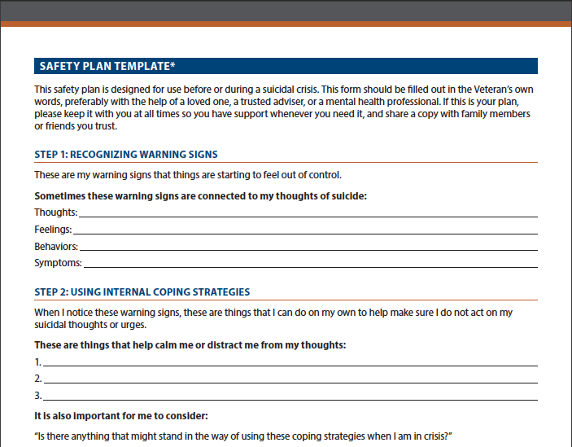
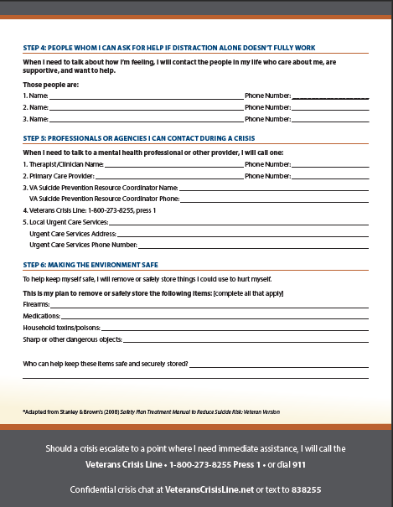
What does a safety plan look like?
Notes:
Included in all slide decks: [Safety Planning 3 of 3]

Slide 57
Support and Resources
Notes:
[Included in all slide decks: Safety Planning]

Slide 58



VA support and resources
VA Mental Health Resources
Suicide Prevention Coordinators
Resource Locator
Veterans Crisis Line
Make the Connection
VA.gov
VA’s Community Provider Toolkit
Coaching into Care
Vet Centers
VA Caregiver Support
Explore VA
Notes:
Include in all decks
Suicide Prevention Coordinators (SPCs): Nationwide, more than 300 SPCs work closely with Veterans to help them get the support they need to address life’s challenges. In addition to case management work with Veterans, SPCs are the “boots on the ground” for VA’s suicide prevention education initiatives – providing ongoing training to all VAMC clinicians and staff and promoting awareness of suicide risk and prevention through community outreach events. Veterans can contact their local VAMC using the VA Resource Locator to schedule an appointment with an SPC near them.
Resource Locator: Helps Veterans and their families connect with local treatment centers, SPCs, and other programs in their communities for customized support
Veterans Crisis Line is a free, confidential, phone, online chat, and text-messaging service staffed by qualified VA responders – some of whom are Veterans themselves. The Veterans Crisis Line is available to all Veterans, even if they are not registered with VA or enrolled in VA health care.
Make the Connection encourages Veterans and their families and friends to explore topics including health, wellness, and common life challenges and watch videos of Veterans talking openly about their personal experiences with mental health treatment and recovery – all of which are featured on this one-stop website.
VA.gov: features mental health information, resources, and services available to Veterans, Service members, and their families
VA’s Community Provider Toolkit: features trainings, resources, and information to support the mental health services you provide to Veterans. You can find information on connecting with VA, understanding military culture and experience, as well as tools for working with a variety of mental health conditions.
Coaching into Care: provides guidance to families and friends of Veterans on how to talk to the Veterans in their lives about seeking help for mental health and substance abuse challenges
Vet Centers around the country provide Veterans with the opportunity to speak with a therapist – many of whom are Veterans themselves – for free, without an appointment. Regardless of a Veteran’s enrollment status with VA, Veterans can receive same-day support at their local Vet Center with proof of combat service of a DD214. In addition, any Veteran who has experienced military sexual trauma while serving in the military is eligible to receive counseling regardless of gender or era of service.
VA Caregiver Support: features resources for family caregivers. Call VA’s Caregiver Support Line at 1-855-260-3274 to learn more about how VA’s trained professionals can help caregivers find the services and support that are right for them and the Veterans they care for.
Explore VA offers a fast and easy way for Veterans and their families to learn about programs they may be eligible for. VA benefits and services help Veterans take care of family members, buy a home, earn a degree, start a career, stay healthy, and so much more.

Slide 59
Additional support and resources for women Veterans
Health Care
VA Women Veterans Health Care and VA Center for Women Veterans: Access information about health care services available to women Veterans
WomensHealth.gov: Explore resources and information for women who are in suicidal crisis and are looking for support
U.S. Department of Defense Safe Helpline: Find confidential 24/7 support for members of the DoD community — Service members, Veterans, and civilian employees — who have experienced sexual assault. Call 1-877-995-5247 or chat online
Services and Benefits
Homeless Women Veterans: Discover information about VA housing benefits, housing stability programs, and more
Women Veterans Resource Directory: Learn the rights of women Veterans and connect with organizations providing assistance and services; from the U.S. Department of Labor’s Women’s Bureau
Women Veterans Call Center: Get answers to questions and concerns facing women Veterans, their families, and caregivers about VA services and resources. Call 1-855-VA-WOMEN (1-855-829-6636)
Notes:
Include when relevant [Resources: Women Veterans 1 of 2]

Slide 60
Additional support and resources for women Veterans
(Continued)
Transitioning and Career
National Veterans Foundation’s Women Veteran Resources: Connect with resources to help women Service members transition to civilian life and create their own leadership opportunities
The American Legion’s Guide for Women Veterans: Discover information for women Service members transitioning to civilian life
The National Resource Society for Women Veterans: Access career assistance, housing assistance, and life coaching for women Veterans transitioning into the civilian workforce
Notes:
Include when relevant: [Resources: Women Veterans 2 of 2]

Slide 61
Additional support and resources for aging Veterans
VA Retirement and Financial Literacy Education Program: Discover tools and information to help Veterans better understand and manage their finances during retirement
VA eBenefits: Explore detailed information on topics relevant to older Veterans, including retiree allowances, VA retirement benefits, disability compensation, and health care for retirees
VA Health Benefits: Explore the Veterans Health Administration’s medical benefits packages and eligibility information
Veteran Benefits Administration Locator: Find the nearest Veterans Benefits Administration regional office to get valuable information about VA benefits and financial assistance
Notes:
Include when relevant [Resources: Aging Veterans]

Slide 62
Additional support and resources for LGBTQ Veterans
VA Office of Diversity and Inclusion: Learn about VA policies for, and benefits available to, LGBT Veterans and employees
The Trevor Project: Find crisis intervention and suicide prevention services for LGBT individuals under age 25. To access support, call the Trevor Lifeline at
1-866-488-7386, text the word Trevor to 1-202-304-1200 (standard text messaging rates apply), or chat online
GLBT National Help Center: Access confidential peer support for LGBT individuals of all ages. Call the hotline at 1-888-843-4564, or chat online to connect with a caring responder
American Military Partner Association: Connect with resources for family and friends of America’s LGBT Service members and Veterans, including confidential support networks, special events, and more
Notes:
Include when relevant [Resources: LGBTQ Veterans]

Slide 63
Additional support and resources for Veterans who are transitioning from service
GI Bill®: Explore the VA tools and resources that can help Veterans pursue college degrees, on-the-job training, apprenticeships, or nondegree programs
Moving Forward: Learn about VA’s free online educational and life-coaching program that teaches problem-solving skills to help transitioning Service members effectively manage life’s challenges
AfterDeployment: Access resources to aid the transition process and improve job performance
Real Warriors: Explore true stories of Service members who have reached out for support and obtained the help they needed to live well
inTransition: Access be­havioral health care support and personal coaching for transitioning Service members and Veterans as they move between health care systems or providers. Enrollment in the program takes just one phone call:
1-800-424-7877
Notes:
Include when relevant [Resources: Transitioning Veterans]

Slide 64
Additional support and resources for attempt survivors
“Information and Support After a Suicide Attempt”: Explore a wide range of resources to support Veterans and their families following a suicide attempt (From VA)
“After an Attempt” guide for survivors of a suicide attempt: Find support for beginning the emotional healing process and addressing suicidal thoughts (From the U.S. Department of Health and Human Services)
“After an Attempt” guide for family members: Discover support and resources for family members after a loved one’s suicide attempt (From the U.S. Department of Health and Human Services)
“After an Attempt” guide: Support for attempt survivors and information about how to take care of yourself after an attempt (From the Suicide Prevention Council)
Rocky Mountain MIRECC for Suicide Prevention: Explore resources for Veterans, Service members, and their families in dealing with suicide and suicidal behavior, including guides for talking to children about a family member’s suicide attempt
Notes:
Include when relevant [Resources Attempt Survivors]

Slide 65
For More Information
For more information, the full toolkit is available online at www.VeteransCrisisLine.net/starttheconversation
Notes:
Include in all decks

Slide 66
Contact your local VA Suicide Prevention Coordinator
Name:
Phone Number:
Email:
Notes:
Include in all decks. SPCs insert your contact information here.

